Slide 1
Microservices
Just another buzzword?
@dotjson

Slide 2











Whose using them?
“Microservice architecture is not a silver bullet… However, we have found that there are a huge number of benefits which vastly outweigh any disadvantages.”
– Matt Heath, Technical Lead @ Hailo

Slide 3
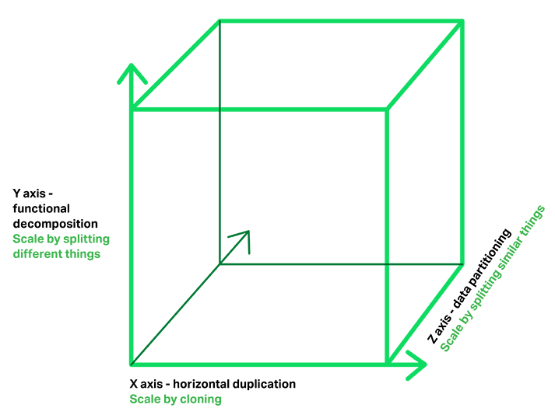



Why are they using them?
Scale
Agility
Availability
Flexibility
The Art of Scalability - Martin L. Abbott & Michael T. Fisher

Slide 4
What does “microservice” mean?
Distributed architectural design style
A microservice is a single component of a larger microservice system
Encapsulation and modularization at the service level
How small actually is micro?
It is a refinement of SOA, DDD, and Component-based SE
Complimented by cloud computing, DevOps and new workloads

Slide 5




Microservice Principles
Microservice application
V1.0.1
V2.0.3
V1.0.0
A microservice is:
independently versioned
independently deployable
independently scalable
State
V1.0.1
V1.0.0
Code
V1.0.1
V1.6.2
V1.0.1
REST API
REST API
HTTP
A microservice will:
be developed by a small engineering team
contain both code and dedicated state
encapsulate a business function
support mixed languages, tools and platforms*
A microservice can:
talk to other microservices via standard protocols
use other microservices via standard interfaces
update, fail and restart whilst the system is running

Slide 6


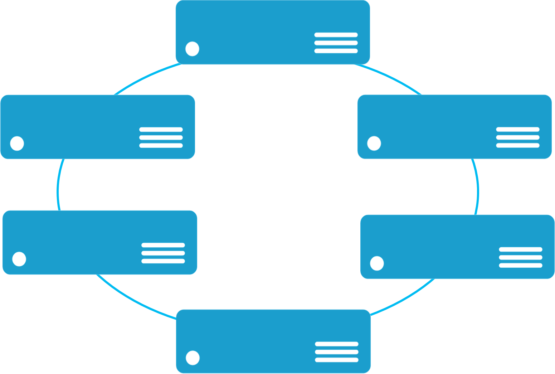


Monolithic application approach
Microservices application approach
: Presentation
App 1
App 1
App 2
A microservice application separates functionality into separate smaller services.
: Application
: Data
Scales by cloning the app on multiple servers/VMs/Containers
Scales out by deploying each service independently creating instances of these services across servers/VMs/containers

Slide 7
What’s the catch?
What about network latency?
Who authorises who?
How do the microservices know about each other?
How do we monitor our system?
What language? Protocol? Interface? Should we use?
What happens if a service fail?
How do I perform complex queries?
CAP Theorem!?
“Turns out that selecting the runtime and language is just one step in building products in a microservices architecture. Another important aspect an organization has to think about is what stack to use for things like RPC, resilience, and concurrency.”
- Phil Calçado, Director @ DigitalOcean (formerly SoundCloud)

Slide 8
Service Fabric
Managing the complexity

Slide 9
Microsoft Service Fabric A platform for reliable, hyperscale, microservice-based applications
Microservices
High Availability
Data Partitioning
Service Fabric
Health Monitoring
Container Orchestration & lifecycle management
Hybrid Operations
Self-healing
Simple programming models
High Density
Rolling Upgrades
Low Latency
Placement Constraints
Replication & Failover
Stateful services
Fast startup & shutdown
Resource balancing
Hyper-Scale
Automated Rollback
Azure
Private cloud
Other clouds

Slide 10
Service Fabric Cluster
The runtime environment your microservices run on top of
Microservices
Nodes
Cluster
What happens if a microservice is too greedy? Or a node fails?

Slide 11

Demo

Slide 12
Programming Models
Reliable Actors
Many small independent units of state (i.e. sensor, smart car, etc.)
Single threaded objects
Service Fabric manages concurrency and granularity of state
Service Fabric to manages communication
Reliable Services
You can use reliable collections (Dictionary and Queue) to store and manage state
You control concurrency and granularity of state
You manage communications between services

Slide 13

Antifragility

Slide 14
Summary
Scalability
Independently scalable services gives us higher utilization and reduces cost
Agility
Enables rapid delivery of new capabilities and shortens MTTR
Availability
Isolated errors allows service degradation and service replication enables fail over
Flexibility
Ability to use the right tool, languages and platform for the job
Adaptability
Update and deprecate microservices incrementally on the live system

Slide 15
@dotjson

